Slide 1


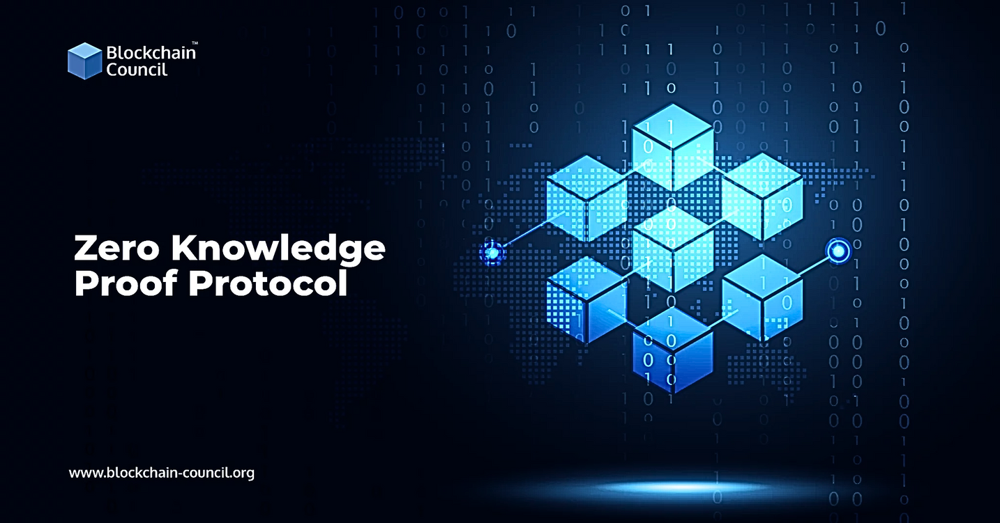
Chandigarh University
DECENTRALIZED
AUTONOMOUS
ORGANIZATION
Presented To: Ms. Priyanka Jammwal
Presented By: Baby Monal and Sehajpreet Kaur

Slide 2
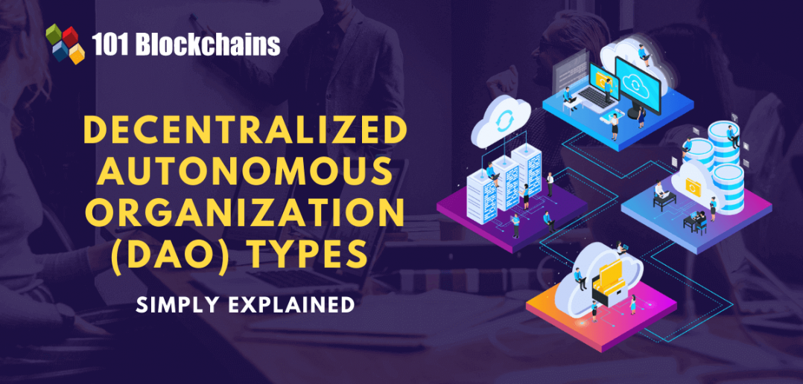
INTRODUCTION
The research paper highlights issues in modern organizations due to centralized decision-making and manual processes, proposing a solution through DAO (Decentralized Autonomous Organizations).
DAO advocates for decentralized decision-making, community ownership, and automation to address inconsistencies and trust concerns, prioritizing global implementation with a focus on security and compliance.
The proposed work explores traditional organizations' challenges in the digital age and emphasizes the transformative potential of DAOs and smart contracts in improving organizational dynamics by implementing a dapp.
The overarching goal is to enhance the global implementation of these technologies for more efficient and dynamic organizations.

Slide 3


METHODOLOGY
Gitpod: Cloud-based IDE enabling web-based coding, testing, and project development.
Remix IDE: Comprehensive tool suite for Ethereum-compatible smart contract development and analysis.
MetaMask Wallet: Mobile/web app for remote Ethereum wallet management and interaction with decentralized apps.
Hardhat Configuration: Framework for building digital currency applications with customization, compilation, debugging, and deployment capabilities.
Localhost: Virtual server address for testing and developing applications by uploading source code and exporting data.

Slide 4
COMPONENTS OF DAO
Smart Contracts: Self-executing agreements encoded in code, automating key DAO functions like proposal processing, voting, fund management, and token transfers.
Token Holders: Individuals with voting and decision-making rights, collectively influencing DAO actions through a voting process, and sometimes receiving financial incentives.
Proposals: Covering various topics such as project funding or rule changes, proposals play a key role in DAO decision-making.
Voting Mechanism: Enables token holders to participate in decision-making through an on-chain voting system, directly influencing blockchain-based approval or rejection of proposed actions.

Slide 5
ADVANTAGES
CHALLENGES
Decentralization: Operating on a decentralized network fosters trust, eliminates single points of failure, and promotes democratic decision-making.
Regulatory Uncertainty: Navigating evolving regulatory frameworks poses challenges, as DAOs often operate in a legal landscape without clear guidelines.
1
1
Security Concerns: Vulnerabilities and attacks, such as smart contract bugs and security loopholes, pose risks to the funds and operations of DAOs operating on blockchain networks.
Transparency and Trust: Leveraging blockchain ensures transparency in decision-making and fund management, reducing the risk of fraud and enhancing trust among members.
2
2
Governance and Decision-Making: Ensuring fair and inclusive decision-making, preventing manipulation, and addressing conflicts of interest among token holders are ongoing challenges for the effective functioning of DAOs.
3
Efficiency and Automation: Smart contracts automate functions like proposal processing and voting, reducing the need for intermediaries, streamlining processes, and improving overall organizational efficiency.
3

Slide 6
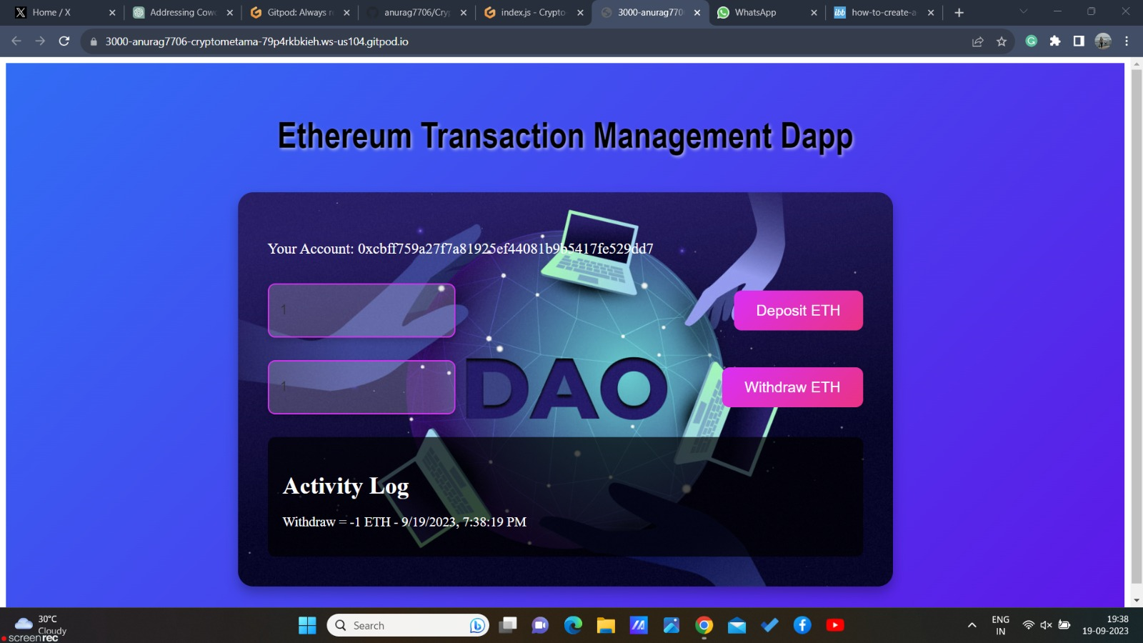
Implementation focuses on a DAPP for Ethereum transactions using MetaMask.
Smart contract deployment on Hardhat involves Node.js, npm commands, and code compilation.
01
Frontend development on localhost:3000 using "npm run dev."
MetaMask connection via extension installation and wallet setup for Ethereum network compatibility.
02
DAPP enables Ethereum transactions with deploy and withdraw functions.
Web3.js or ethers.js library usage for Ethereum network interaction, integrating seamlessly with MetaMask.
03
IMPLEMENTATION OF A DAPP

Slide 7
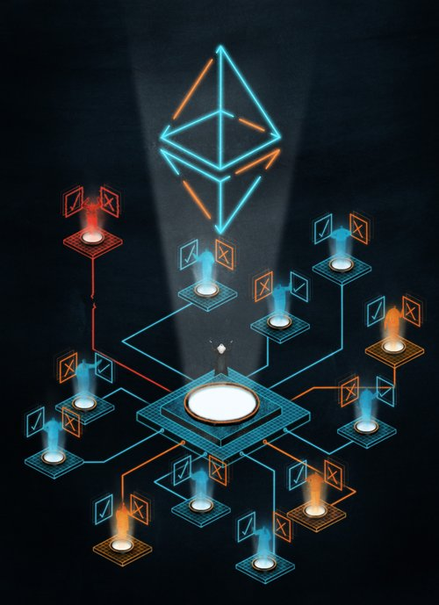
FUTURE TRENDS AND CONCLUSION
Widespread Adoption: Anticipate increased DAO adoption in diverse industries, including arts, entertainment, and healthcare.
Web3 Integration: DAOs will lead the Web3 movement, collaborating with dApps, DeFi, and blockchain platforms.
Gaming DAOs: Gain traction in the gaming industry, impacting game development and virtual economies
In conclusion, the exploration of Decentralized Autonomous Organizations (DAOs) highlights their transformative potential, offering decentralized governance, transparency, efficiency, and global inclusivity. Despite challenges, DAOs are poised to revolutionize organizational structures, fostering transparency, inclusivity, and innovation in the evolving landscape.

Slide 8
References
[1] Wang, S., Ding, W., Li, J., Yuan, Y., Ouyang, L., & Wang, F.-Y. (2019). "Decentralized Autonomous Organizations: Concept, Model, and Applications." IEEE Transactions on Computational Social Systems, 6(5), 870-878. doi: 10.1109/TCSS.2019.2938190.
[2] El Faqir, Y., Arroyo, J., & Hassan, S. (2020). "An overview of decentralized autonomous organizations on the blockchain." In 16th International Symposium on Open Collaboration, OpenSym 2020. doi: 10.1145/3412569.3412579.
[3] Liu, L., Zhou, S., Huang, H., & Zheng, Z. (2021). "From Technology to Society: An Overview of Blockchain-based DAO." IEEE Open Journal of the Computer Society, 2, 204-215. doi: 10.1109/OJCS.2021.3072661.
[4] Faqir-Rhazoui, Y., Arroyo, J., & Hassan, S. (2021). "A comparative analysis of the platforms for decentralized autonomous organizations in the Ethereum blockchain." Journal of Internet Services and Applications. doi: 10.1186/s13174-021-00139-6, pp. 2-20.
[5] Sims, A. (2019). "Blockchain and Decentralized Autonomous Organizations (DAOs): the evolution of companies?" Social Science Research Network, pp. 423-458.
REFERENCES

Slide 9
THANK YOU

